Slide 1
Business Intelligence
How To Automate Economic Policies

Slide 2
What is Business Intelligence?
Extract Knowledge from Big Data
You can manage virtually unlimited amount of Data
You decide how to represent the data
Transform Knowledge into Decision
You can have virtually unlimited explicit representations of your Environment
You can decide how to Optimize and Automate a decision making Policy
Leverage Computing Power to guarantee
You can take immediate decisions at virtually unlimited Scale (ex. Worldwide)
Your decisions are measurable and quantifiable (no margin for Error)

Slide 3
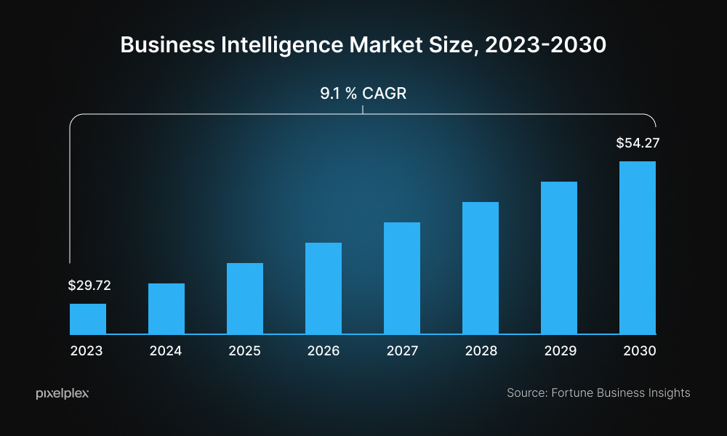
BI - Industry Trend
Source: https://www.fortunebusinessinsights.com/business-intelligence-bi-market-103742
Note: For Salary Information Google “Salary Business Intelligence” (Leverage Glassdoor / Fyi / Payscale)

Slide 4
Why Business Intelligence?
Exposure to Artificial Intelligence and Software Exponential Trends
Effort: Requires Continuous Learning and Re-Training
Benefit: You can implement Innovative Solutions at very large scale
Specialization & Risk Management
Effort: Requires Sharp Communication Abilities to Influence Stakeholders
Benefit: You can produce highly measurable Value if the solution is Adopted
Optimize and Automate Decisions
Effort: Requires Data and its correct Representation
Benefit: Removes the cost of taking decisions, and the costs of bad decisions taken by humans introducing an efficient resource allocation policy

Slide 5
How Business Intelligence?
Every Leader Takes Decisions Based on
Goal and Interests
Information and Context Available
Knowledge and Reasoning Capabilities
The 3 Decision Pillars depend on
Environment Representation
Decision Horizon and Granularity / Frequency
Cost of Failure and Reward of Success

Slide 6
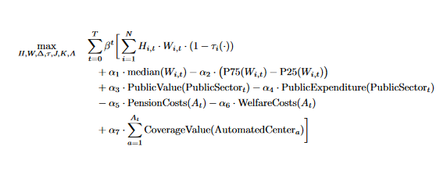
A Practical Example – Macroeconomic Policy
A Goal
Maximize Size of Italian Labor Force and The Median Income
Keep Incentives to cap the 75th Percentile and the 25th Percentile maximum Income gap
Minimize The Amount of Public Expenditure
Keep Service Level Quality stable based on mix of Civic Surveys and KPI factors

Slide 7
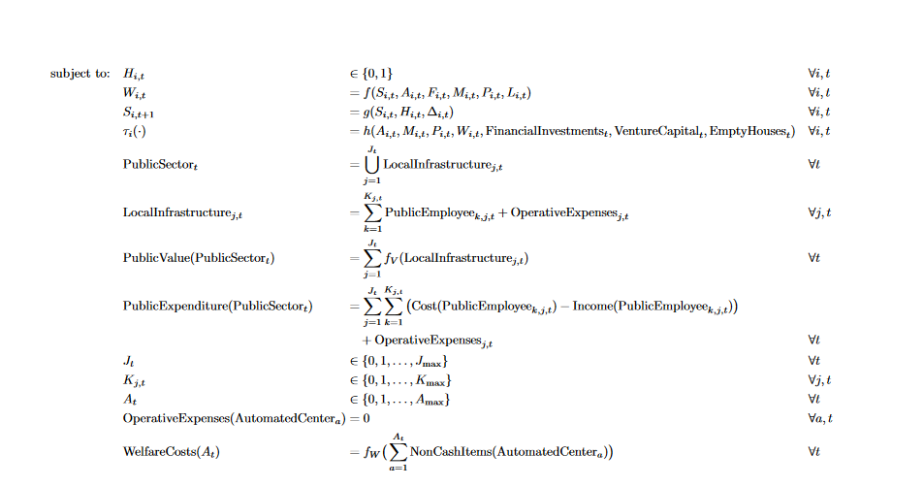
A Practical Example – Macroeconomic Policy

Slide 8
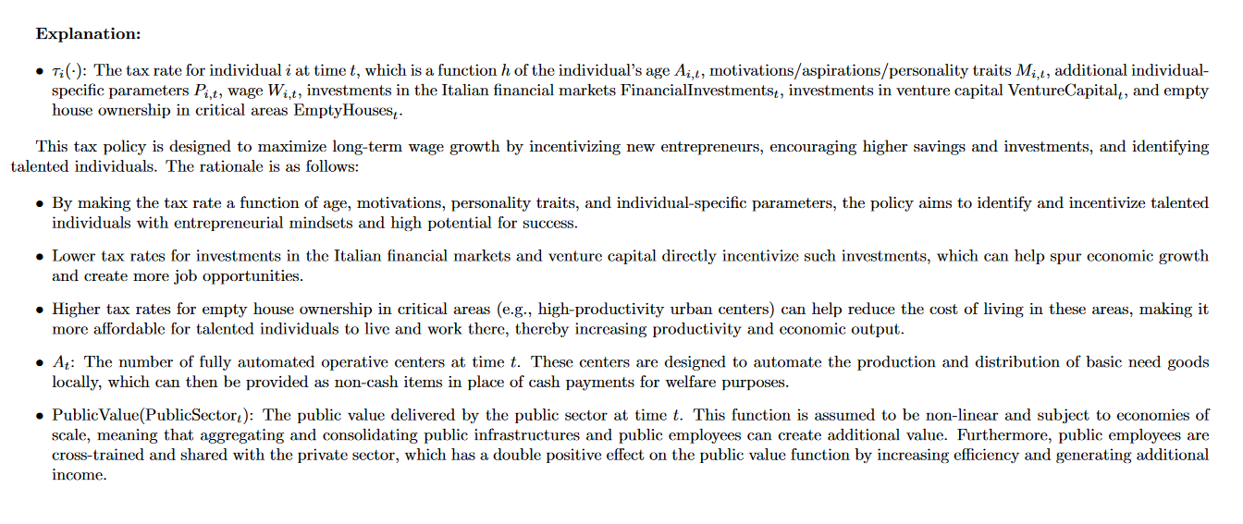
A Practical Example – Macroeconomic Policy

Slide 9
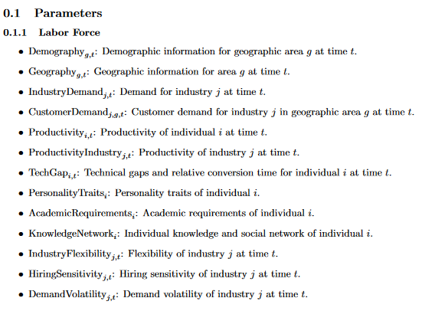
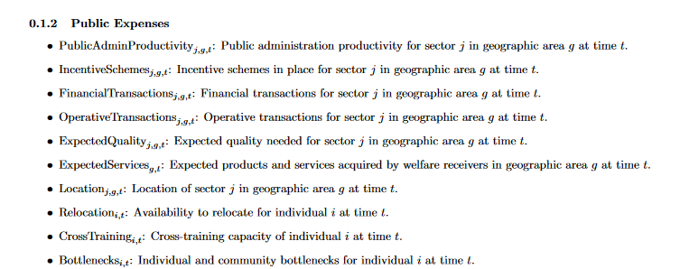
A Practical Example – Macroeconomic Policy
Information and Context

Slide 10
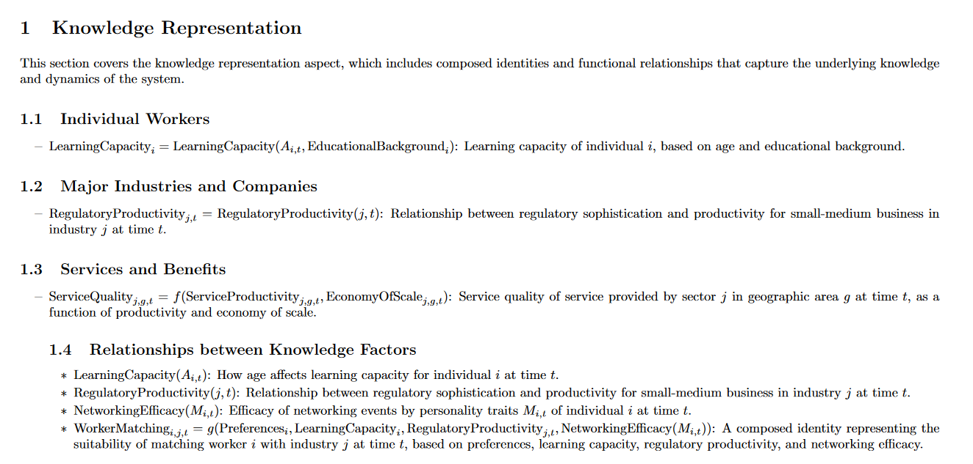
A Practical Example – Macroeconomic Policy
Knowledge
Knowledge: how you represent information / data and its relationship.

Slide 11
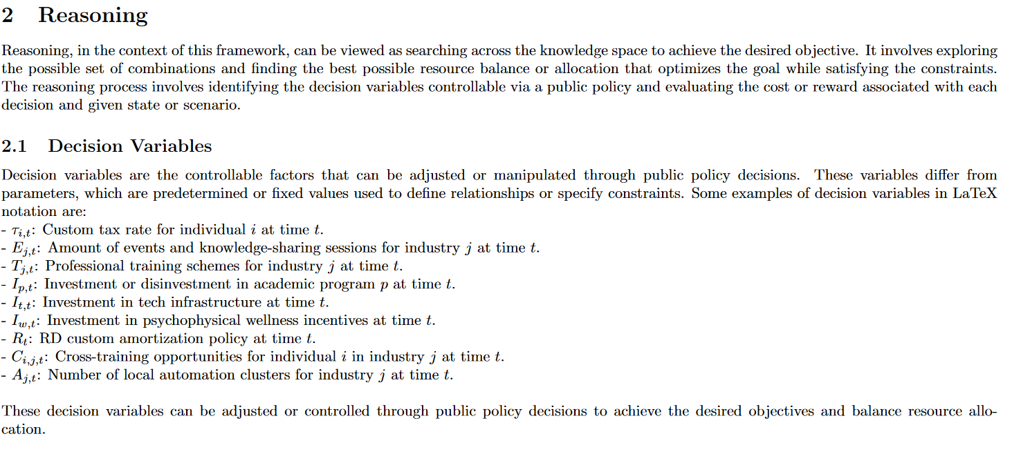
A Practical Example – Macroeconomic Policy
Reasoning
Reasoning: how you process / search across knowledge to achieve your desired objective

Slide 12
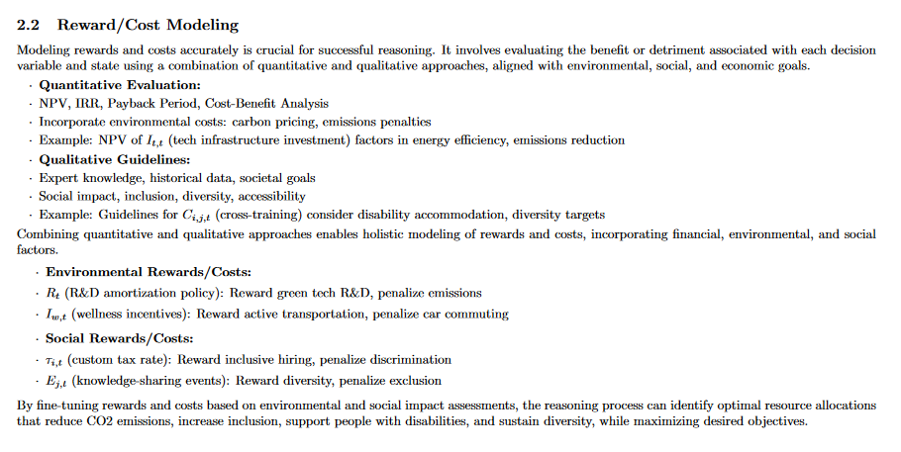
A Practical Example – Macroeconomic Policy

Slide 13
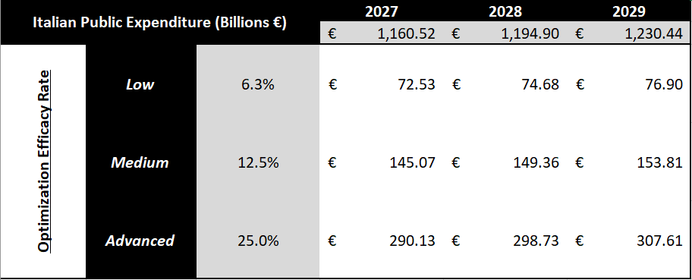
A Practical Example – Macroeconomic Policy
In the best case scenario, an efficient resource allocation via an advanced Business Intelligence infrastructure could save up to 300 billions € each year of the Italian Public expenses
If it is followed by an equal amount of tax reduction for the 22 Millions of Italian Workers, the median net salary could switch from 1750 € to approximately 3000 € each month, incentivizing saving and consumption

Slide 14
Business Intelligence Risk Management
Run / Update your Control Tower Frequently
Evaluate against actuals on a daily or weekly basis
Identify the entropy magnitude and the root causes
Adjust or add new representations or objectives or rewards across time
Source of Risk
Garbage in – Garbage out Data effect
How you represent data / phenomena affects decisions outcome
Inaccurate Relationships or cost/rewards expectations

Slide 15
Business Intelligence Technologies
Technologies – *Including Amazon Web Services (AWS)
ETL / SQL
Postgre SQL
DuckDB (usable with Python to write SQL queries)
Polars (highly scalable Python module)
Data Lake / Warehouse
Amazon Redshift
Amazon S3 / Amazon Athena hint: check awswrangler if you use Python
Apache Spark / RDS / DynamoDB
Transforming / Modeling
Python
Typescript (Cloud Development Kit)
Linear Programming frameworks / modules
Computing Power
EC2 / Lambda
Amazon Sage Maker
Amazon Bedrock (Large Language Models – for advanced Explainability)
Visualization / Interface
Streamlit (Python)
HTML / CSS / Javascript
Power BI / Quicksight

Slide 16


Code Dive Deep – Let’s Practice Together
Control Tower
https://naivecustomtaxratepolicy-egunxtrcq5dtm2z32y6ucm.streamlit.app/
Source Code
https://github.com/StefanoCiccarelli/naive_custom_tax_rate_policy/tree/main

